Slide 1
Google Stock Time Series Forecasting Using Machine Learning
Presented By:
K.Praveen Vardhan Raju
K.Anish Reddy
Y.Mukesh
J. Sai Kumar
M.Alekhya
Guided By:-
G.Aravind Reddy

Slide 2
Abstract
The project focuses on forecasting Google stock prices using time series analysis and machine learning techniques. It utilizes historical stock data (open, high, low, close, adjusted close, and trading volume) to predict future prices. Data preprocessing, including handling missing values, feature scaling, and time-based splitting, ensures a clean dataset. Exploratory Data Analysis (EDA) identifies trends, patterns, and outliers. Feature engineering creates new time-based variables like lag features and moving averages. The project evaluates models such as ARIMA, SARIMA, and LSTM, tuning them with performance metrics like MSE and RMSE. Strengths and limitations of these models are analyzed for stock market forecasting. Practical applications for investors and traders are discussed.

Slide 3
Introduction
Stock Price Forecasting: Predicting future stock prices is a crucial task in finance and investments.
Objective: Use machine learning techniques to forecast Google's stock prices.
Data: Historical stock data of Google, including various market features (open, high, low, close, adjusted close, and volume) over a period.

Slide 4
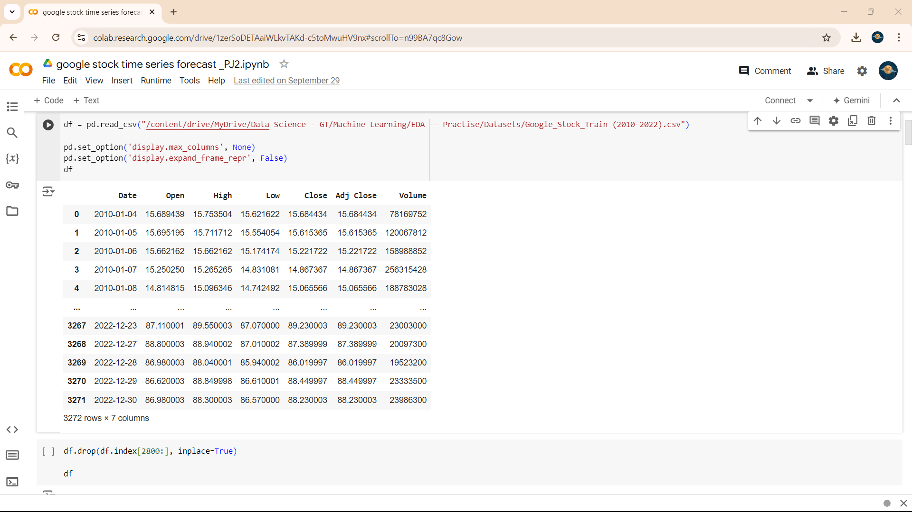
Exploratory Data Analysis (EDA)
1: Data Overview:
Summary of data (dates, features like Open, Close, Volume, etc.).
Mention of data types and range of dates covered.

Slide 5
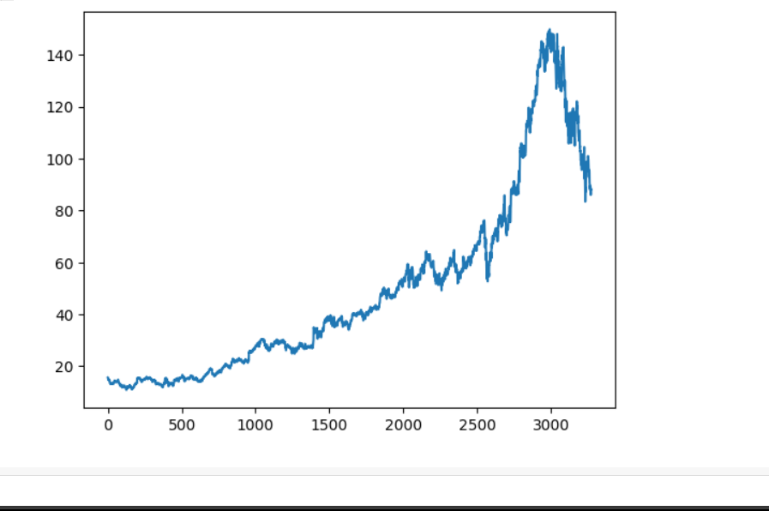
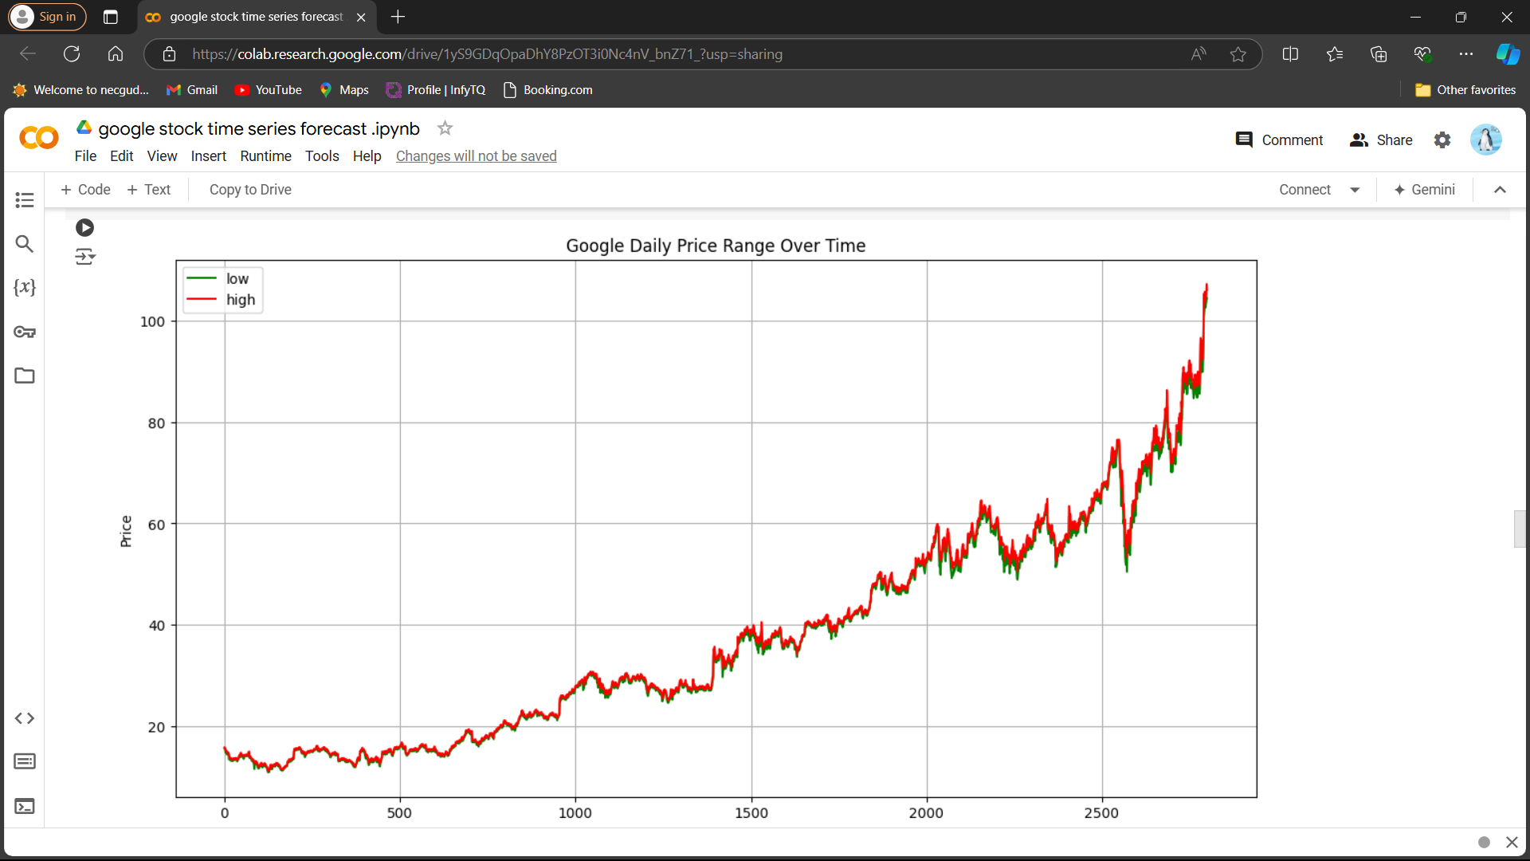
2: Data Visualizations:
Time series plot of 'Close' prices.
Volume trends over time.
Highlight of any observable trends, seasonality, or anomalies

Slide 6
Machine Learning Approaches
Model Choices:
Time Series forecasting models used (e.g., ARIMA, SARIMA, Prophet).
Other models like LSTM, GRU, or traditional regression models.
Feature Engineering:
Creation of lag features.
Rolling statistics (moving averages).
Train-test split and any cross-validation techniques used.
Model Performance:
Comparison of models based on evaluation metrics like RMSE, MSE.
Plot of actual vs predicted values.

Slide 7
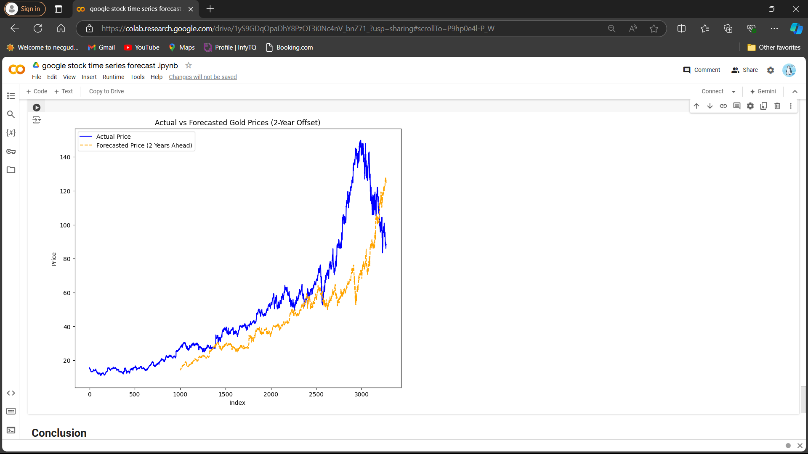
Result

Slide 8
Conclusion
Best Model: Highlight the most effective model.
Limitations: Challenges faced in the project (e.g., volatility, data limitations).
Future Work: Potential improvements (more data, refined models).

Slide 9
Usages
1.Stock Price Prediction: Accurate forecasting of Google's stock price can help investors make informed decisions about buying or selling shares, thus maximizing returns and minimizing risks.
2.Portfolio Management: Predicting stock trends over time allows fund managers to optimize their portfolios by adjusting asset allocations based on expected stock movements, improving overall performance.
3.Risk Management: Machine learning models can detect early signals of volatility in Google's stock, helping businesses and investors to hedge against potential losses and plan for risk mitigation.
4.Algorithmic Trading: The model can be integrated into automated trading systems, where buy or sell orders are executed based on forecasted stock movements, leading to faster and more efficient trading strategies.
5.Market Sentiment Analysis: By correlating the stock forecast with external data such as news or social media sentiment, companies can enhance predictive accuracy and better understand market psychology.
6.Financial Planning: Businesses using Google as a key technology partner or competitor can use stock forecasting to make informed decisions regarding investments, partnerships, or future financial strategies.

Slide 10
Thank you

